Slide 1
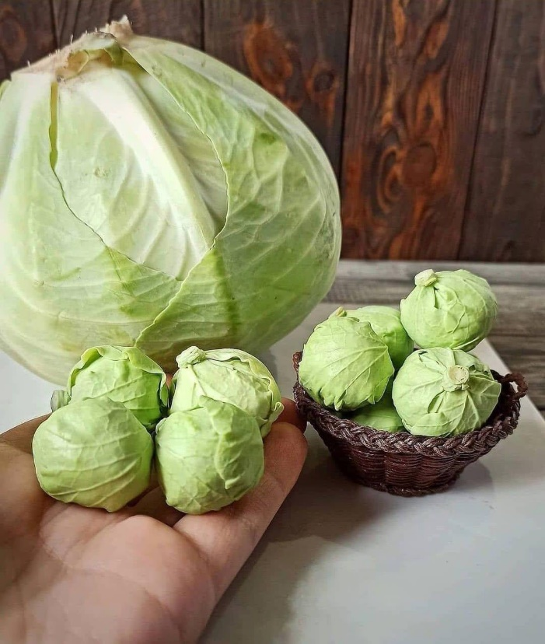
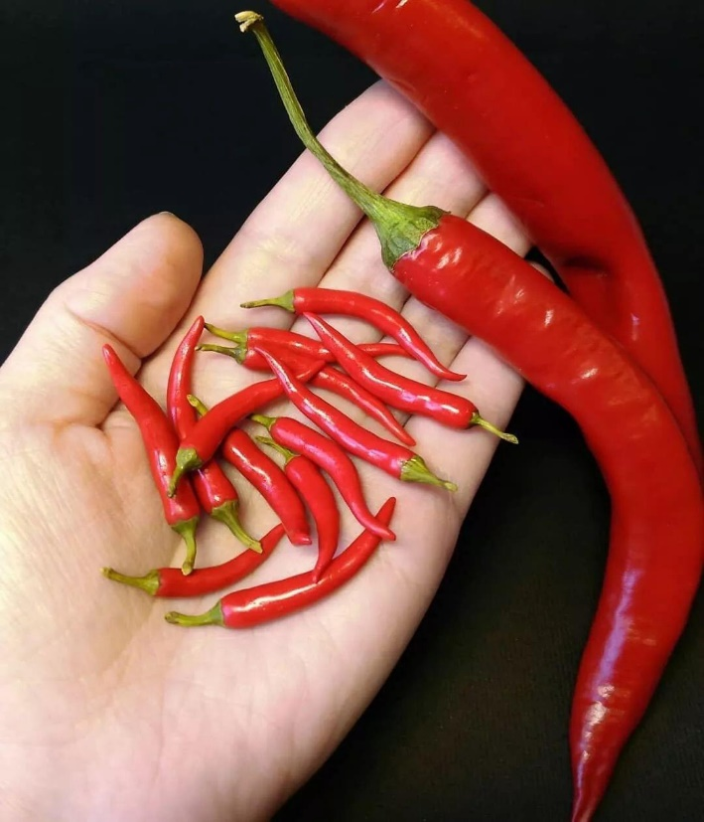
cauliflower
cabbage
chili
broccoli
scallion
carrot
cheese
potato

Slide 2
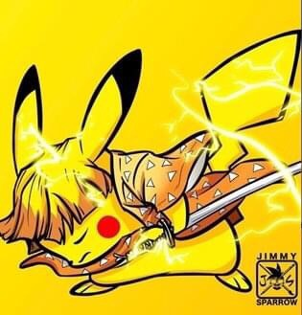
Let’s do some quick review!

Slide 3
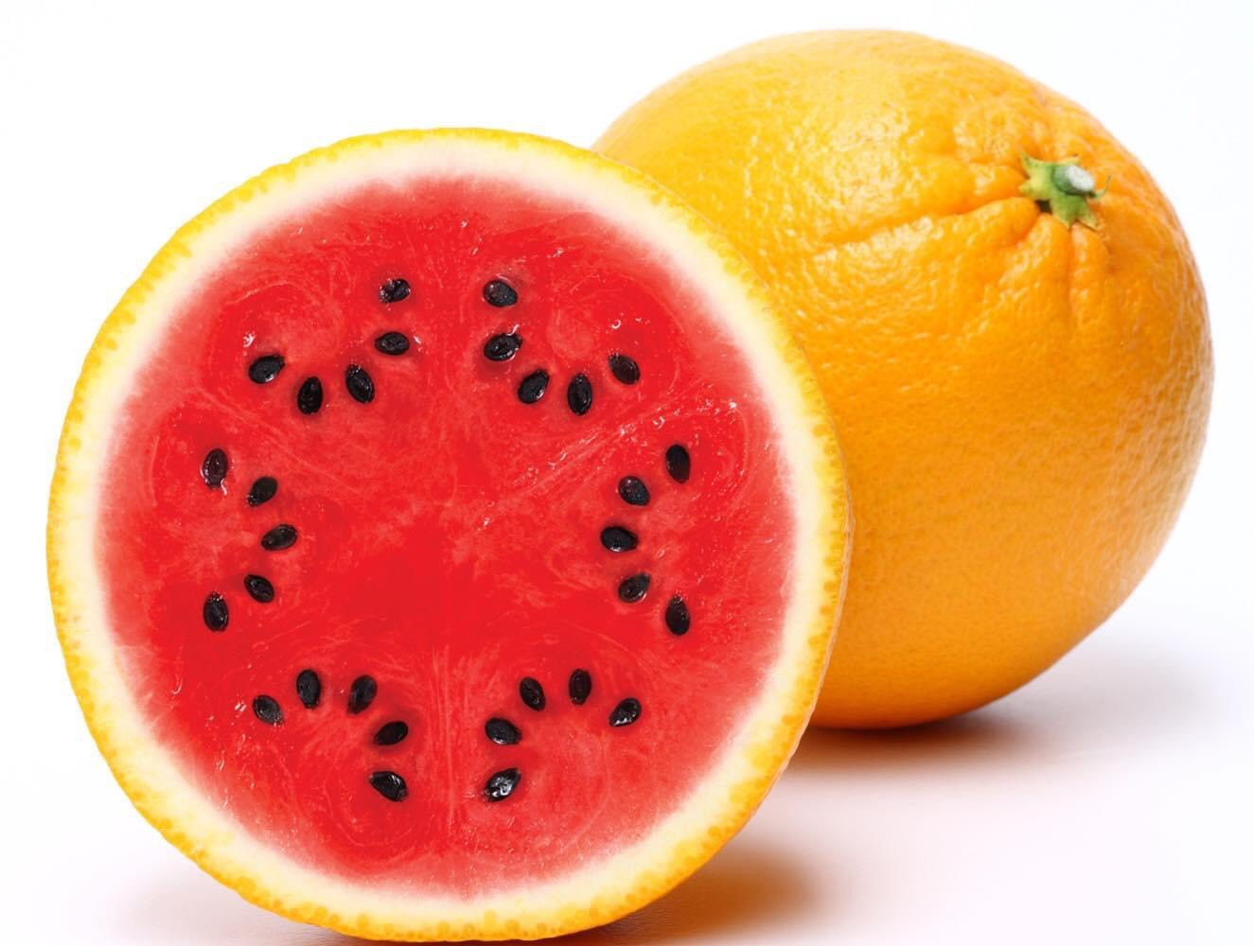
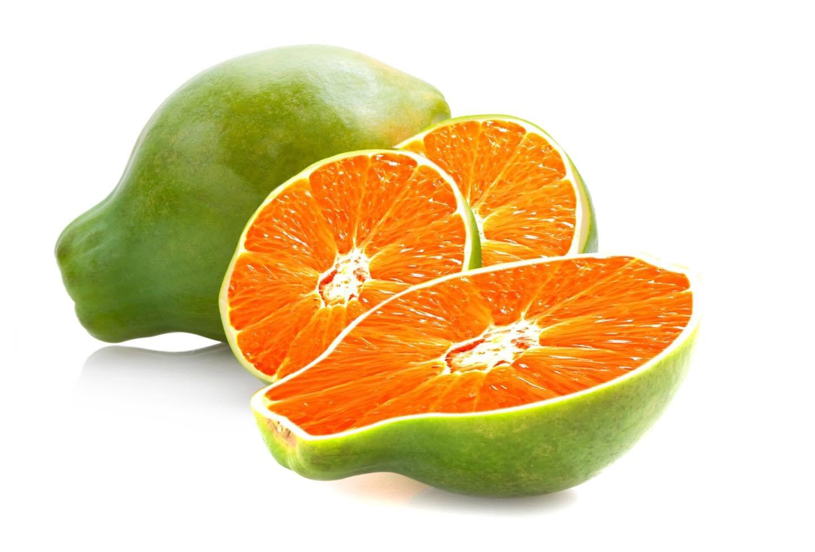
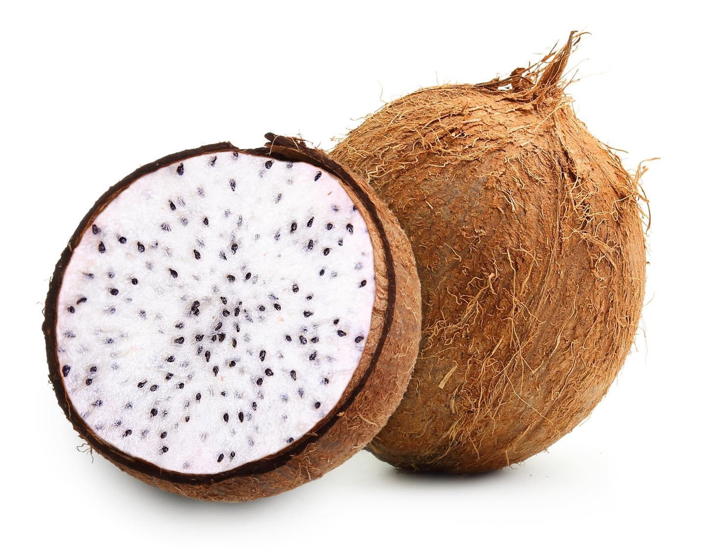
strawberry
+
Litchi
lycheeberry
watermelon
+
orange
waterange
orange
+
papaya
paparange
pitaya
+
coconut
cocoaya

Slide 4
Let’s do some quick review!

Slide 5
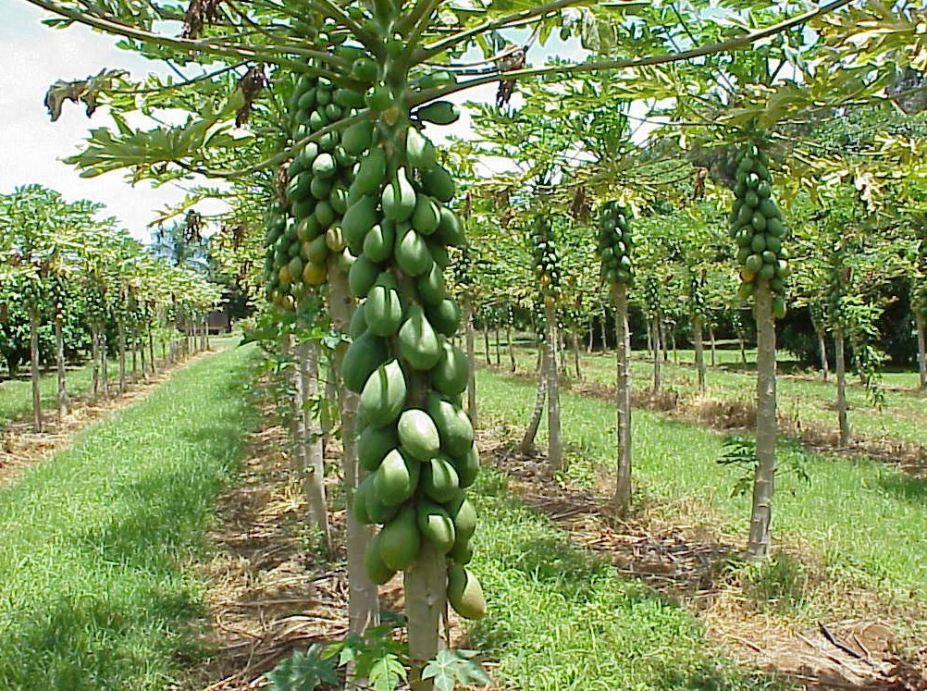
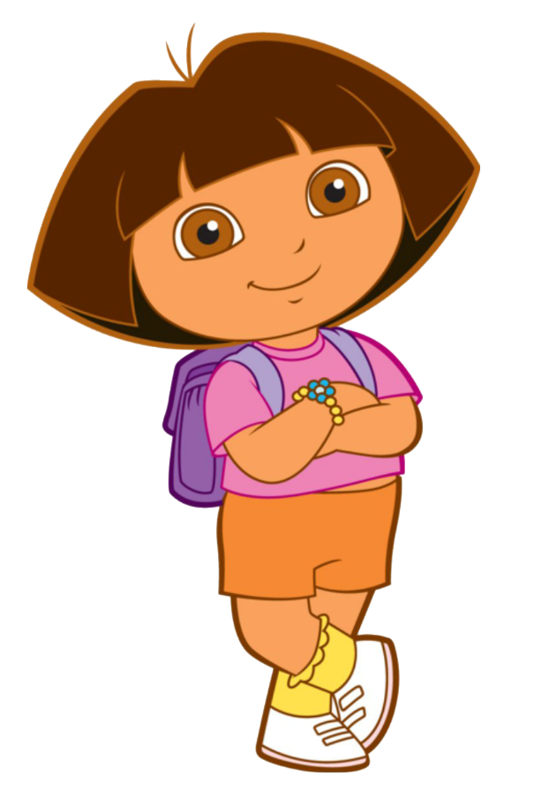
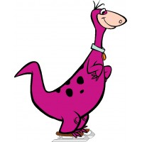
Wow!
What are these?
They’re papayas.

Slide 6
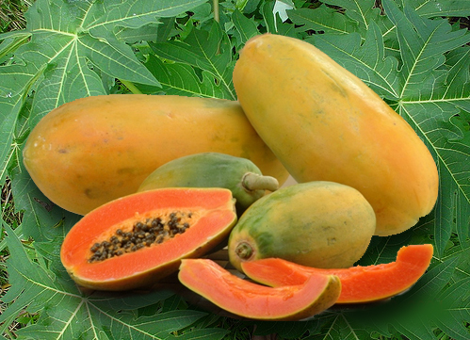
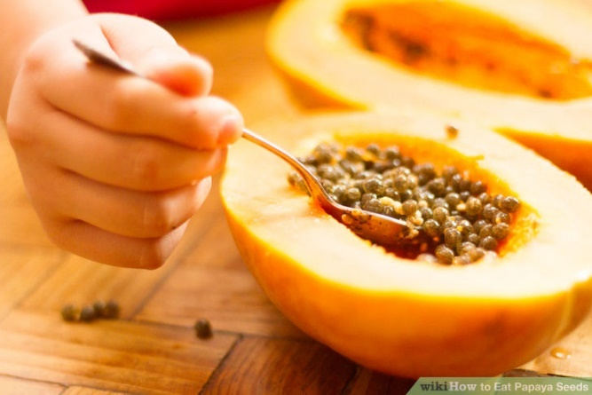
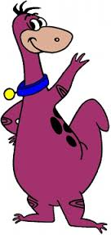
Yes, I do.
Do you like papayas?

Slide 7
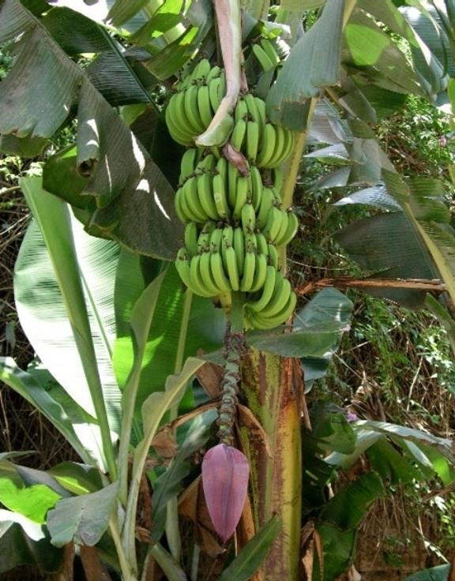
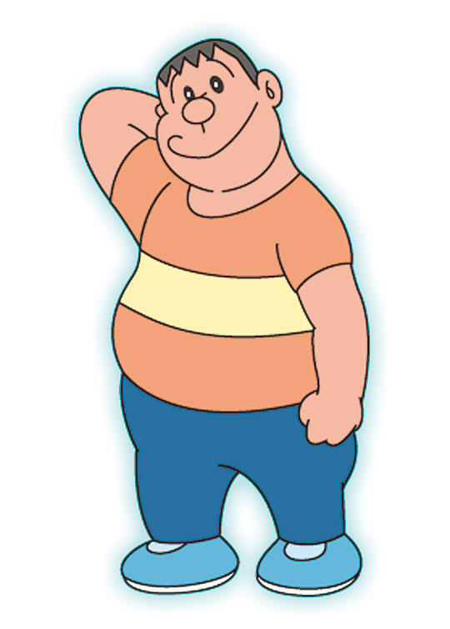
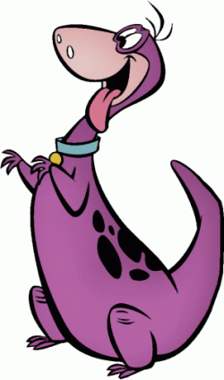
What are these?
They’re bananas.

Slide 8
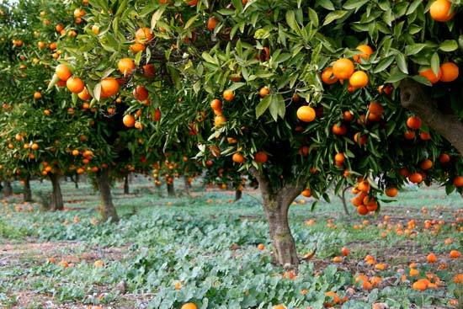
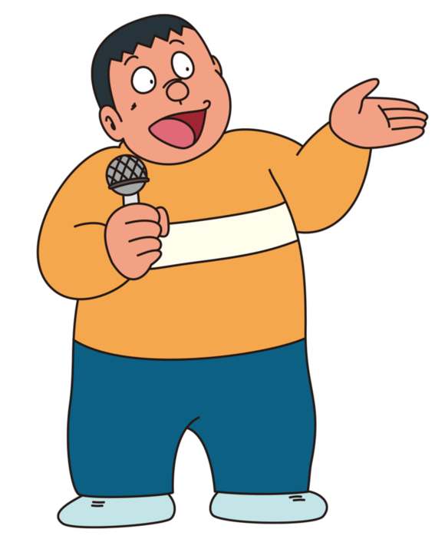
What are those?
They’re oranges.

Slide 9
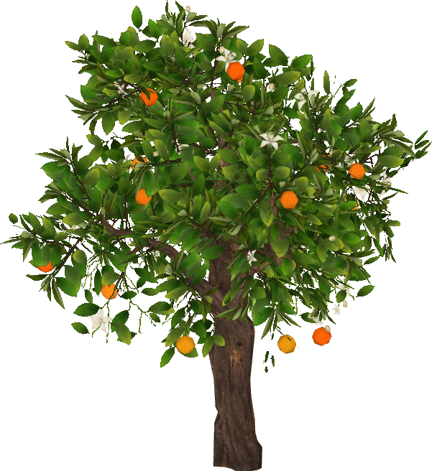
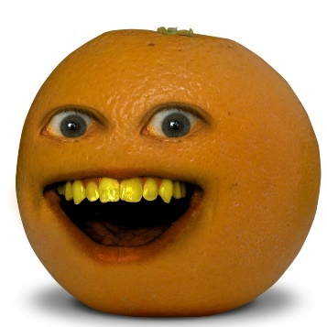
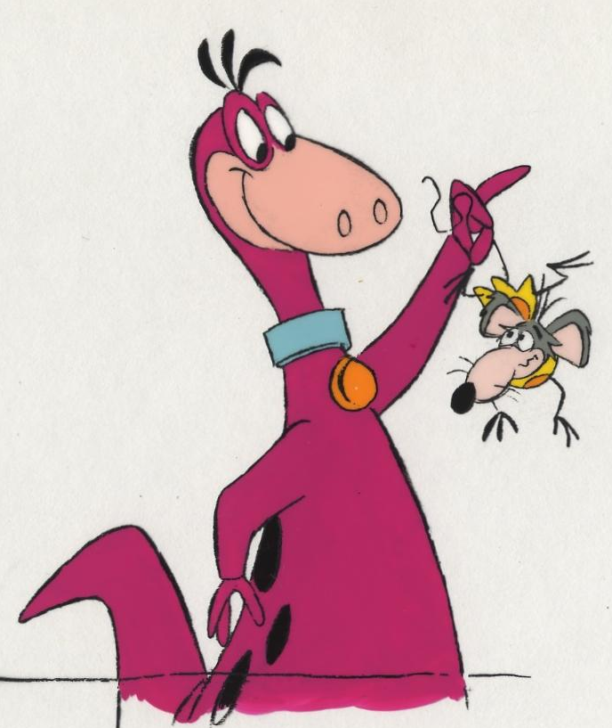
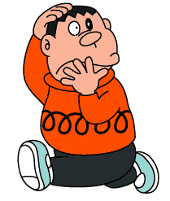
No,I don’t.
Do you like oranges?

Slide 10
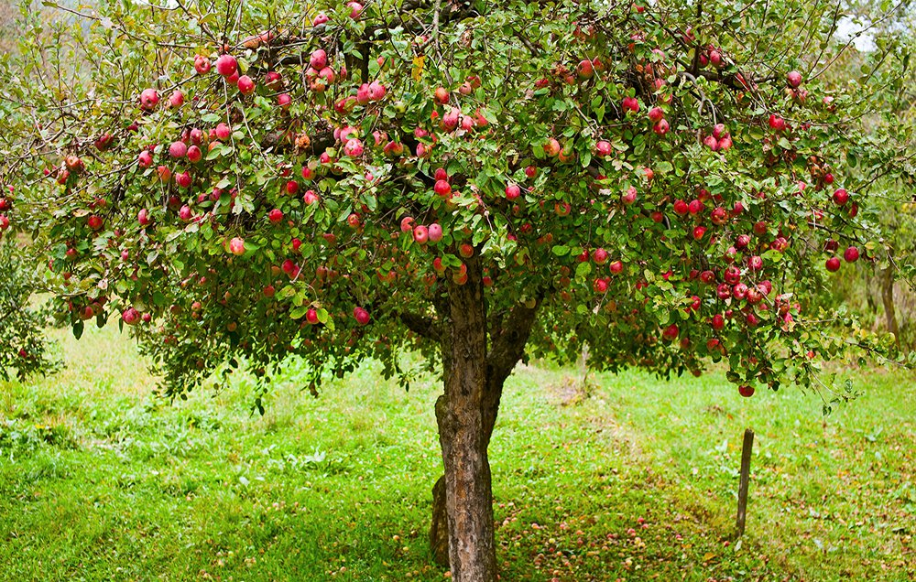
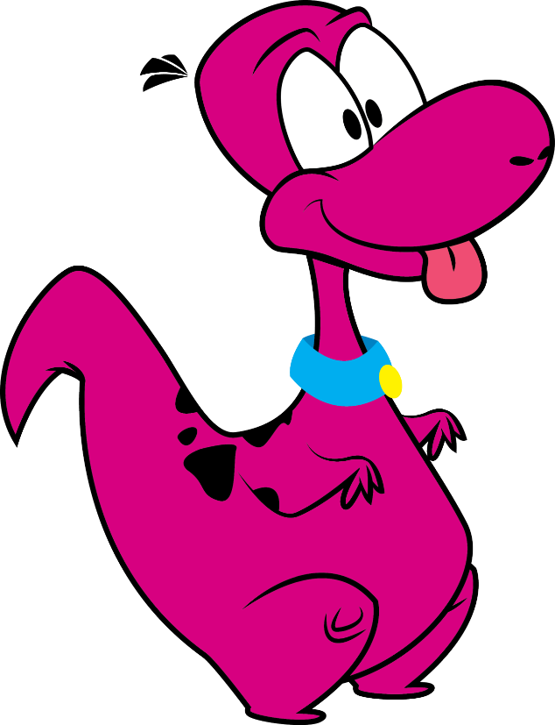
Look,Dino!
Apples.
Great! I like apples.

Slide 11
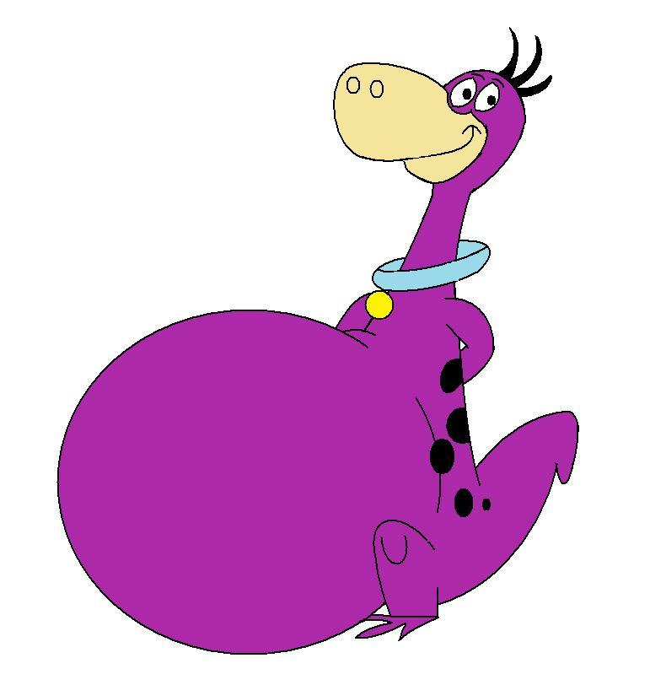
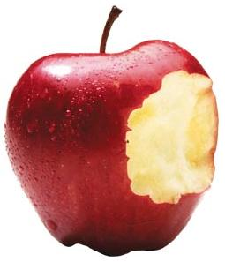
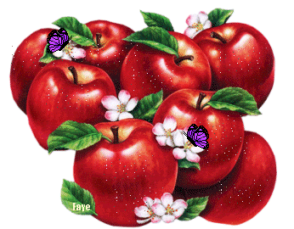
Yummy!

Slide 12
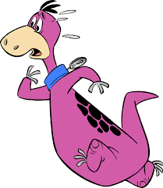
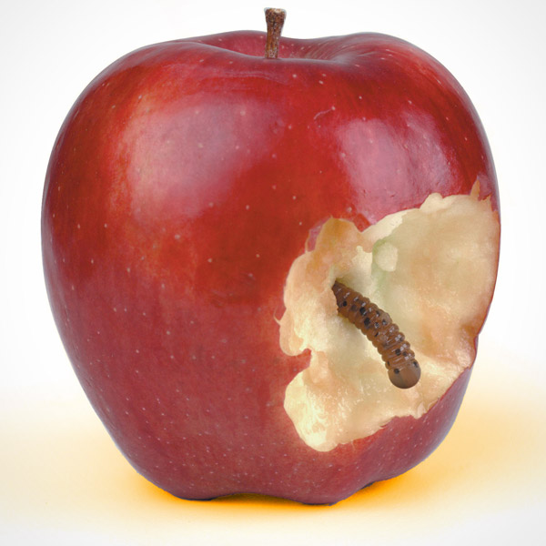
Yuck! I don’t like worms.
Hello!

Slide 14
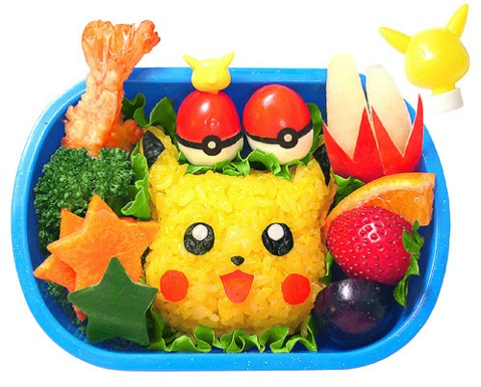

Slide 15
Daily Talk
Watch out!

Slide 16
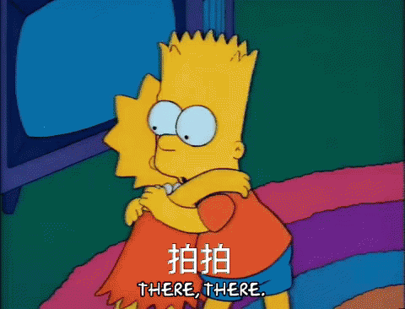
Daily Talk
Are you OK?

Slide 17
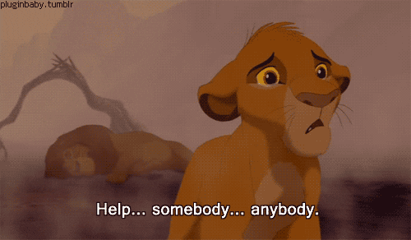
Daily Talk
Help!

Slide 18
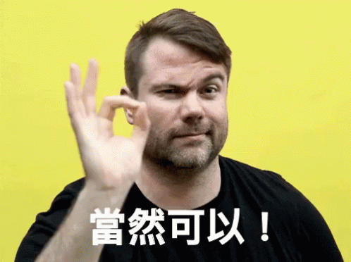
Daily Talk
Of course!

Slide 19
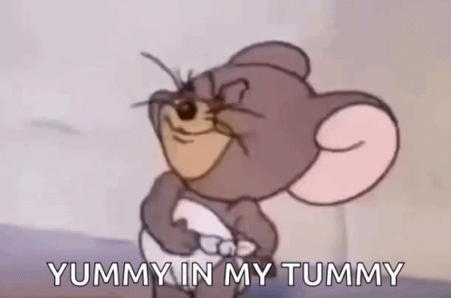
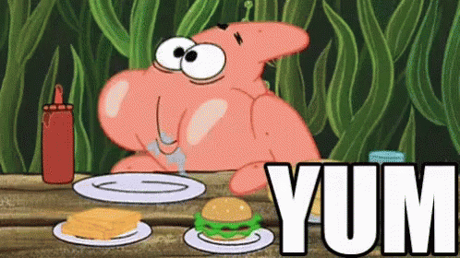
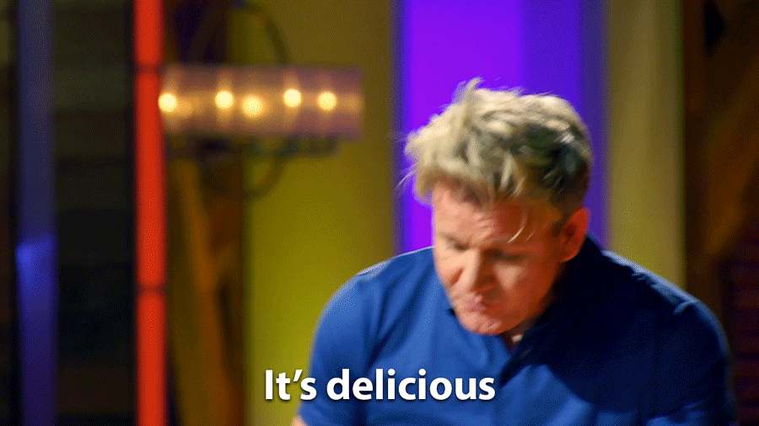
Daily Talk
Yummy!

Slide 20
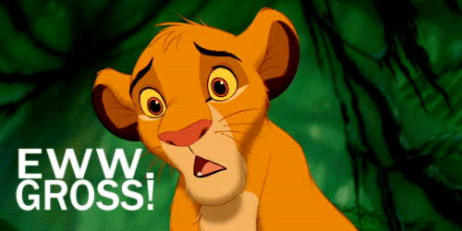
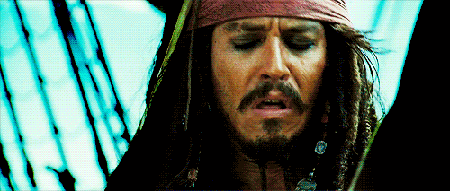
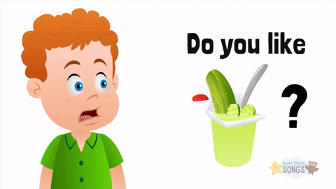
Daily Talk
Yuck!

Slide 22
-og
-ock

Slide 23
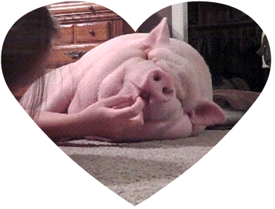
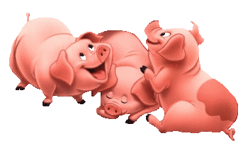
og
h

Slide 24
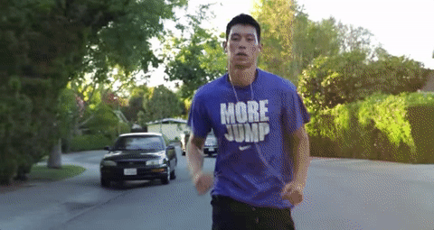
j
og

Slide 25
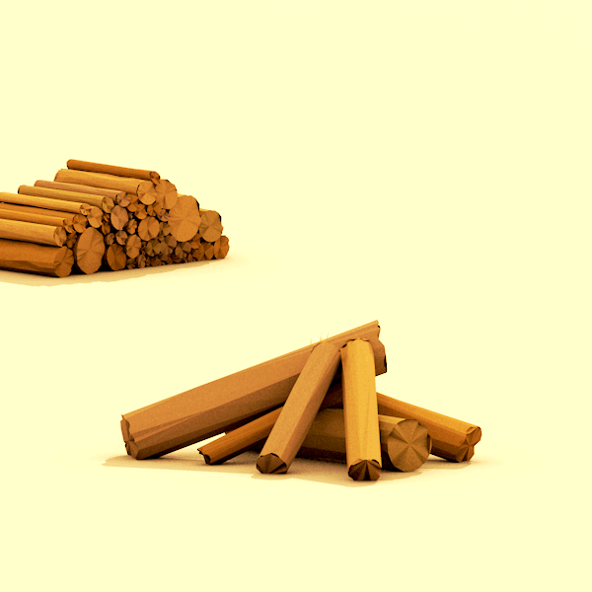
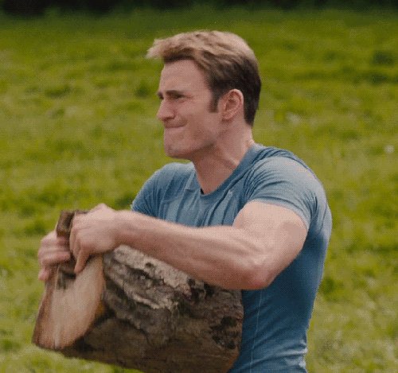
l
og

Slide 26
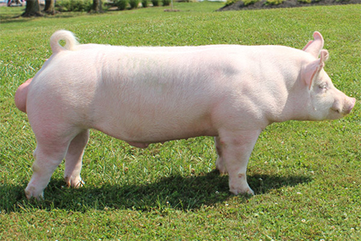
This is a hog.

Slide 27
The hog likes to jog.

Slide 28
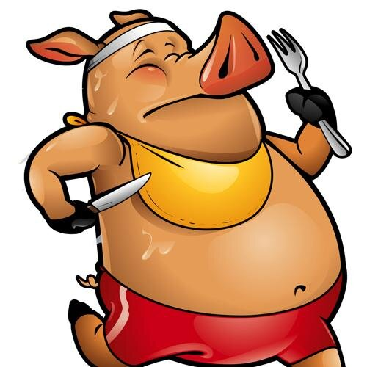
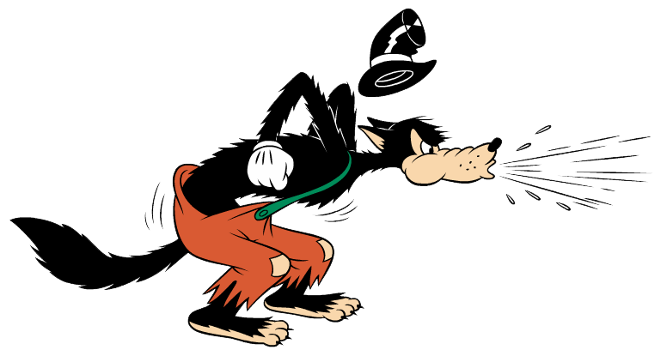
The hog likes to jog with a log.

Slide 29
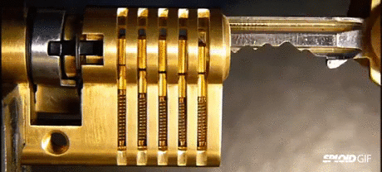
ock
l

Slide 30
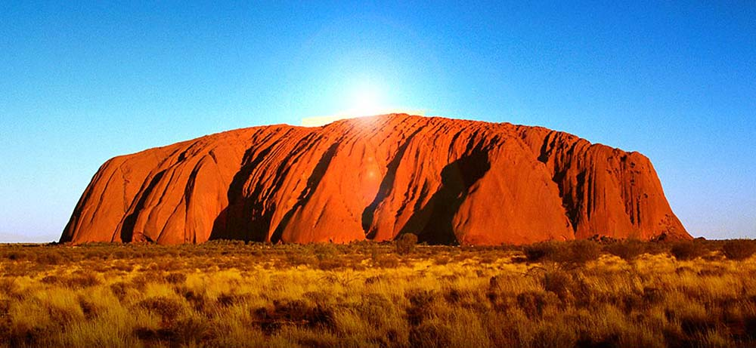
ock
r
Uluru
Ayers Rock in Australia
艾爾斯巨石是世界上最大的獨塊岩體，長35km，寬2km，高330m。

Slide 31
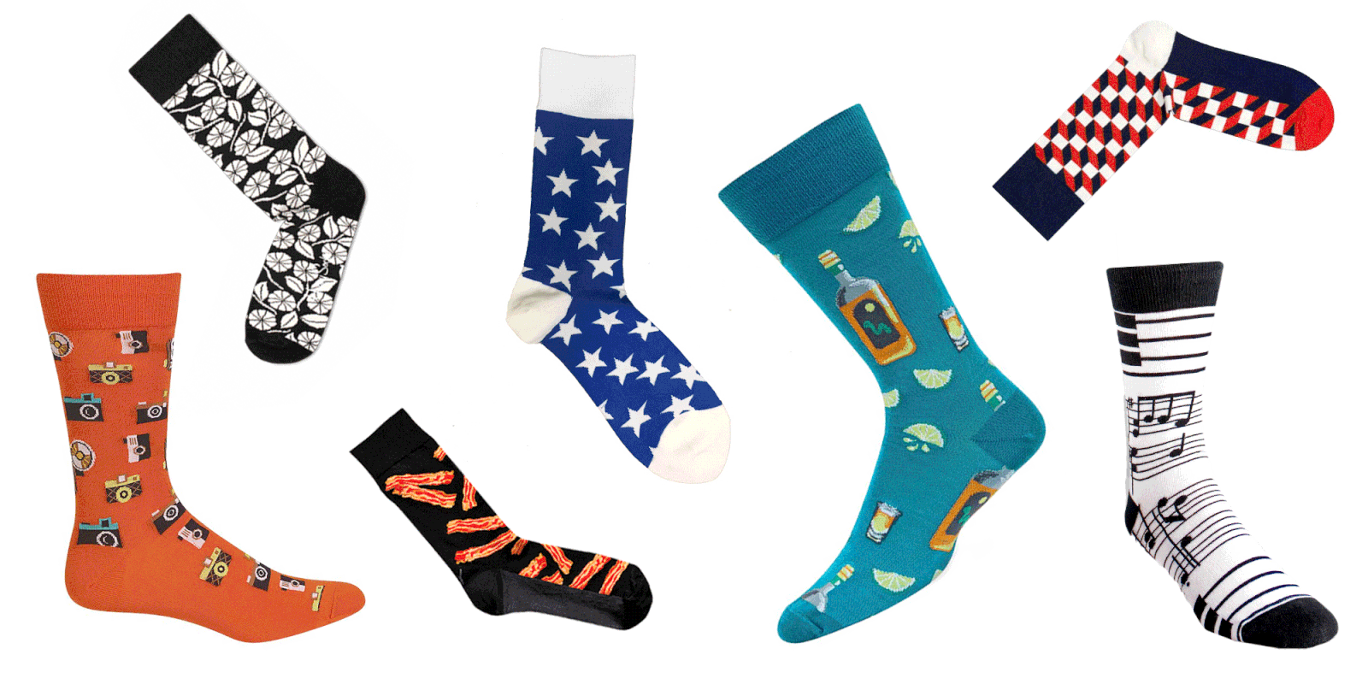
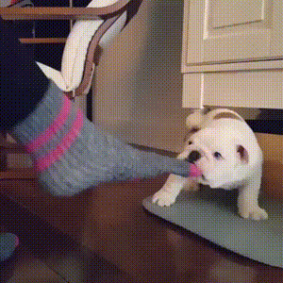
ock
s

Slide 32
This is a lock.
These are locks.

Slide 33
This is a sock.

Slide 34
The lock and the sock are on the rock.

Slide 35
This is a hog.
The hog likes to jog.
The hog likes to jog with a log.

Slide 36
This is a lock.
This is a sock.
The lock and the sock
are on the rock.

Slide 38
am
en
it
og
an
ell
ip
ock

Slide 39
am / an
en / ell
it / ip
og / ock

Slide 40
am / an
en / ell
it / ip
og / ock

Slide 41
am / an
en / ell
it / ip
og / ock

Slide 42
am / an
en / ell
it / ip
og / ock

Slide 43
am / an
en / ell
it / ip
og / ock

Slide 44
am / an
en / ell
it / ip
og / ock

Slide 45
am / an
en / ell
it / ip
og / ock

Slide 46
am / an
en / ell
it / ip
og / ock

Slide 47
am / an
en / ell
it / ip
og / ock

Slide 48
am / an
en / ell
it / ip
og / ock

Slide 49
am / an
en / ell
it / ip
og / ock

Slide 50
am / an
en / ell
it / ip
og / ock

Slide 51
am / an
en / ell
it / ip
og / ock

Slide 52
am / an
en / ell
it / ip
og / ock

Slide 53
am / an
en / ell
it / ip
og / ock

Slide 54
am / an
en / ell
it / ip
og / ock

Slide 55
Homework this week
聽: CD2第24-28首。
說&讀:聽CD時跟著大聲唸。完成3遍
請家長在課本P57簽名可換印章。
背: Unit 3 六個水果單字，下週課堂
進行單字+句型小考。

